Slide 1
SmartHand Transradial Hand Prosthesis
M. Delucchi - C. Demaria - G. Galvagni - E. Piacenti

Slide 2
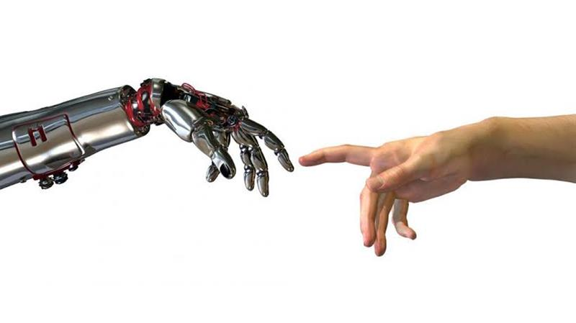
Table Of Contents - Introduction
TARGETED MUSCLE REINNERVATION
PROSTHESIS TECHNOLOGY
CONTROL STRATEGIES
PROSTHETIC HAND DESIGN
HAPTIC FEEDBACK
CONCLUSIONS
Notes:
Hello everyone, In our college group project, we're diving into the Smart Hand Prosthesis—a game-changer in prosthetic design. Today, we'll explore how advanced sensors, lightweight structures, and improved controls are reshaping upper limb rehabilitation. Surgical techniques like TMR and TMSR promise intuitive signals for enhanced functionality. We'll touch on data analysis and machine learning, optimizing prosthetic control. Lastly, we'll delve into haptic feedback, aiming to redefine the tactile experience. Join us as we present our findings, showcasing the future of prosthetics. Thank you

Slide 3
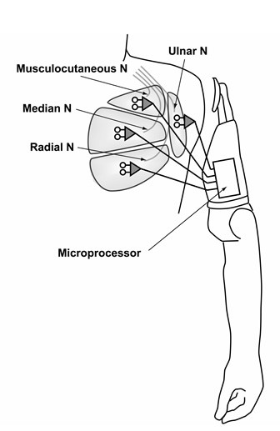
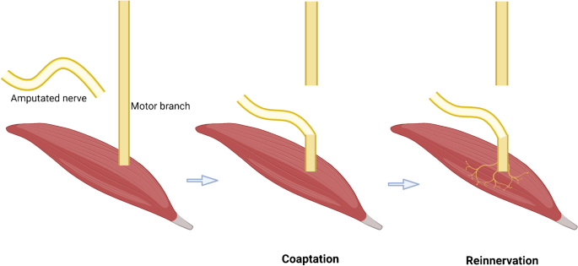
Targeted Muscle Reinnervation
Necessity to increase the number of EMG control signals
More intuitive control
Notes:
One of the main problem in the traditional control regime is the limited number of muscle signals used for the control and the difficulty to learn how to actually controll the prosthesis. Targeted muscle reinnervation (TMR) increases the quantity of EMG control signals because utilises residual nerves of the amputated limb that were still intact and transfer to reinnervate other "target" muscle (such as unutilized muscles in the residual limb or chest that were surgically denervated). So now the procedure is: if I want for example to close my hand, the nerves now makes a contraction of my chest for example, these myosignals are used as control input to actually close the prosthetic hand. (in this sense it is also an intuitive control) As I already said, for controlling the latest prosthetic devices a higher number of muscle signals are required.

Slide 4
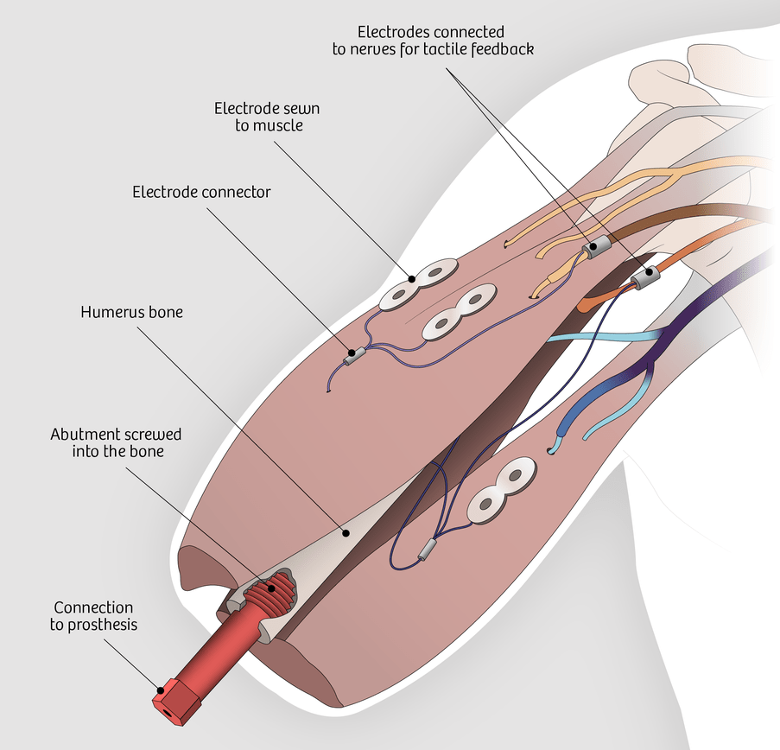
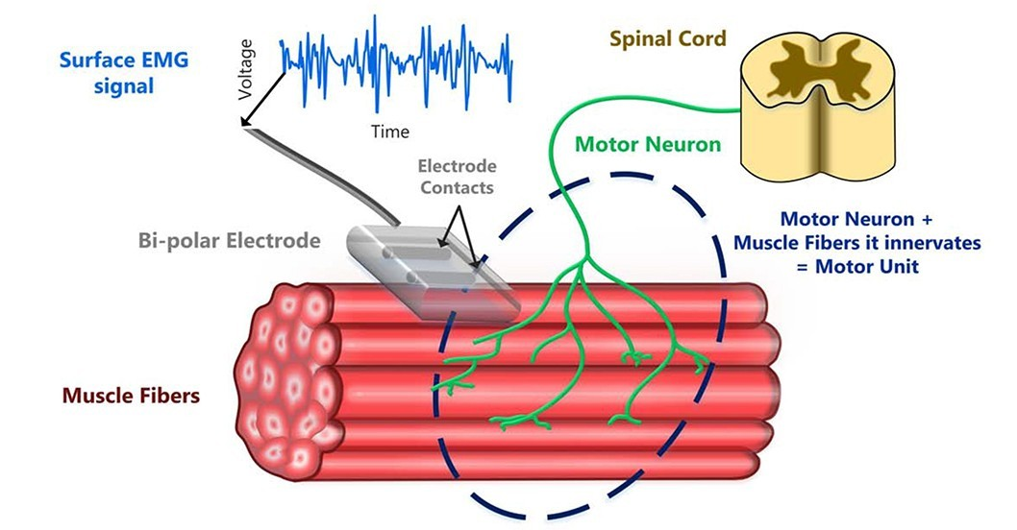
Improvements
Implantable EMG systems: MyoPlant and IMES
Neurostimulation artifact removal algorithms
Osseointegration
Notes:
One of the improvements regards implantable EMG systems such as MyoPlant (record from the muscle surface) and IMES (record from within the muscle) they provide stable relations between the muscle signal source and the implanted electrodes and they can record even deep or small muscle signals. Main problem is the same for both: when I record, I record all the electric signals, so the other myosignals but also the electric signals for the feedback (other improvements) for our control input are noises. So there are n a r alghorithm that applyed to ml p cl improve the signal clarity in presence of sensory feedback via stimulation of the res nerve A other improvement is the use of osseointegration. The prosthesis is connected to a socket that is implanted into the remaining bone of the residual limb. It provides more natural use and omits the problem of prosthesis displacement during heavy use. It also provides the user with a sense of perception, where load is perceived via the bony attachment.

Slide 5
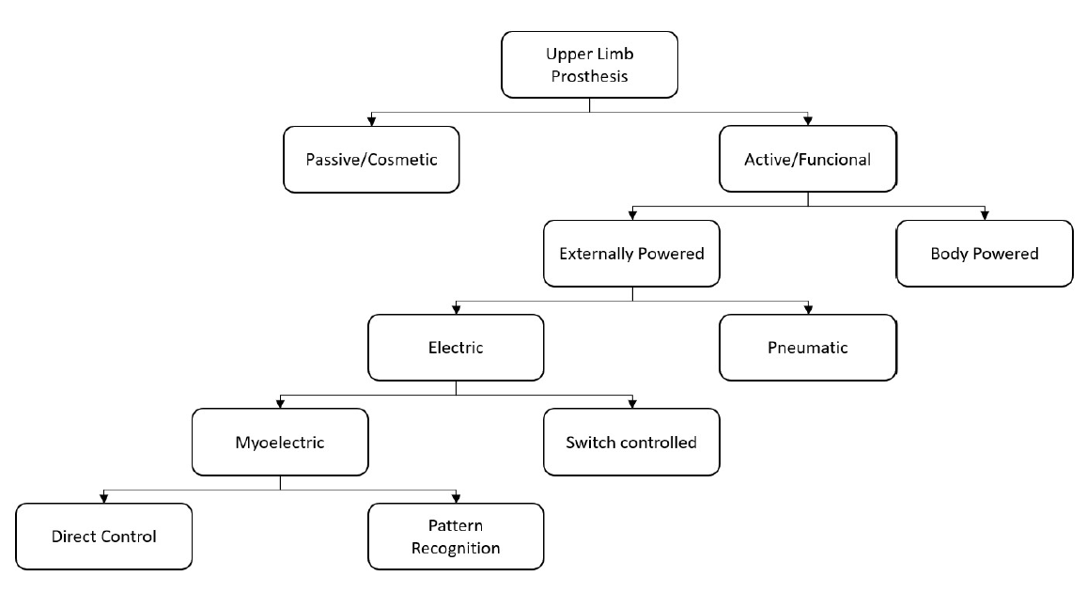
Prosthesis Technology
Cosmetic prostheses are used to restored the aesthetic aspect, while active ones are used to restore, as far as possible, the functionality of the lost arm.
The most used control system is the myoelectric one, which exploits the electromyographic (EMG) signals.
The control system must be simple, direct and user-friendly.
Notes:
Good [morning/afternoon/evening], everyone. Prosthetic technology goes from passive cosmetic designs, the easy one, to the active and functional prosthesis. There are many kinds of controls for the active prosthesis, how you can see from the graph, but my focus today is on the control systems that make Myoletric prostheses work fluenty. This control is divided in two, direct control and pattern recognition.

Slide 6
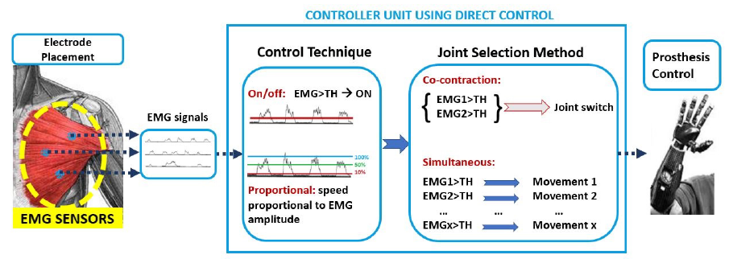
Control Strategies:
Direct Control (DC)
The on/off strategy is used to control one DoF and to allow two opposite movements to exceed a threshold.
In the proportional control strategy, the output applied to the motor is proportional to the level/intensity of the EMG signals’ contraction.
shoulder disarticulation
amputee
Notes:
Direct Myoelectric Control (DC) involves associating EMG signals directly with specific movements. There are two kinds of techniques: on/off and proportional control. With the revolutionary Targeted Muscle Reinnervation (TMR) surgery how Demaria told you before, users gain more control over multiple Degrees of Freedom , thanks to increased muscle sites. On/off has not a very nice control because the patient can only do a movement based on black or with instead Proportional is more precise but difficult to use. Another topic is: How to select the joint I want to move? The joint selection method, is quite difficult because in the case of the co-contraction you need to contract a specific muscle over a threshold or in the case for the simultaneous method you must do all the chain of movements if you need to use the movement before you step position.

Slide 7
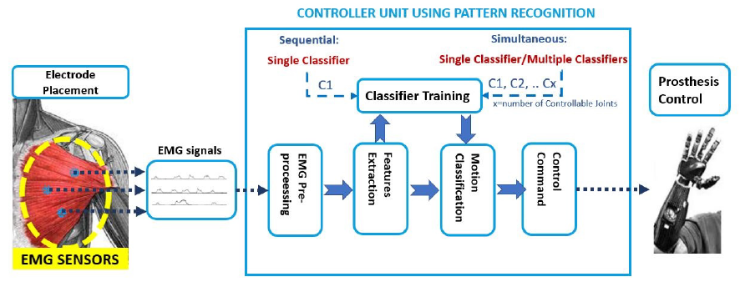
Control Strategies:
Pattern Recognition (PR)
These strategies use machine learning techniques.
The sequential control technique works by only moving one DoF at a time.
The simultaneous method is used to control multi-DoF prostheses, handling more than one joint at the same time.
shoulder disarticulation
amputee
Notes:
Moving on to Pattern Recognition (PR) these involves multiple inputs based on EMG signals with various outputs. PR strategies, use machine learning techniques, helping users' ability to control prostheses more naturally, even for multiple Degree of Freedoms.

Slide 8
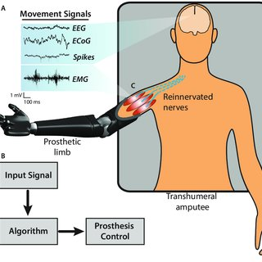
Comparison Between DC and PR Control
Simultaneous PR control works better in path efficiencies, and task completion times when compared to both DC and traditional PR strategies.
Patients generally favor PR control due to its intuitive nature, especially for tasks involving multiple DoFs.
The choice between DC and PR depends on factors such as amputation level, desired control complexity and user preferences.
Notes:
Let's compare Direct Control (DC) and Pattern Recognition (PR). PR outperforms DC in two-DoF tasks, providing a more intuitive and less cumbersome experience. Simultaneous PR control shows promising improvements in take and move things, path efficiencies, and task completion times, surpassing both DC and traditional PR control strategies. The choice between DC and PR depends on factors like amputation level and desired control complexity. Patients generally prefer PR control for its intuitive nature, especially for multi-DoF tasks. Overall, the advancements in Pattern Recognition offer a promising pathway for more natural and efficient prosthetic control.

Slide 9
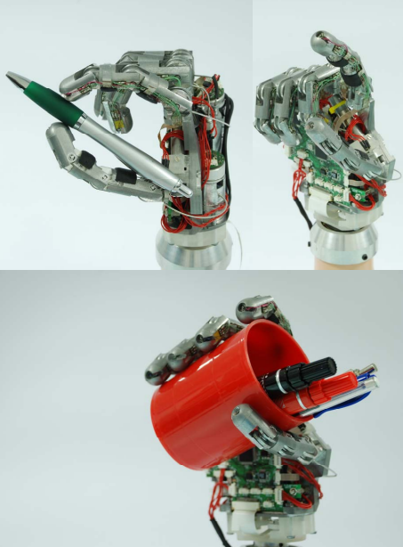
Design Criteria for Prosthetic Hand
Functional Requirements:
Power Grasp (35% of ADLs)
Precision Grasp (30% of ADLs)
Lateral Grasp (20% of ADLs)
Pressing Key/Buttons (7% of ADLs)
Basic Gestures/Natural Position (40% of day time)
Bioinspired Design:
Target Mass (around 400g)
Mimic Human Hand RoM
Minimize Perceived Weight for Ease of Use
Reduce Compensatory Movements & Overuse Syndromes
Performance Metrics:
Speed (whole hand closing in < 2s)
Grasping Force (able to grasp everyday objects)
Low Power Consumption
Notes:
Designing a prosthetic hand involves meeting crucial criteria for functionality, bioinspired replication of human hand characteristics and performance metrics. These criteria are needed to facilitate various grips and gestures, maintaining a natural hand position, mimicking human hand dimensions and behavior and ensuring optimal performance metrics like grasping force, low power consumption and speed. These criteria aim to help with challenges caused by losing a hand, covering physical, emotional and interactive needs.

Slide 10
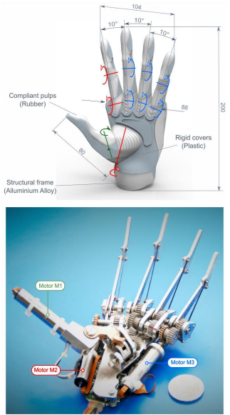
MyHand (2016) [SSSA]
Long Fingers with Two Joints Each: proximal and distal (except for the thumb)
Three Identical DC Brushless Motors:
M1 - flexion/extension of the thumb
M2 - abduction/adduction of the thumb and flexion/extension of the index
M3 - synchronous flexion/extension of the last three fingers
Finger Pads: designed to replicate the human skin
Controzzi M et al. The SSSA-MyHand: A Dexterous Lightweight Myoelectric Hand Prosthesis. IEEE Trans Neural Syst Rehabil Eng. 2017 May;25(5):459-468.
Notes:
The first case of study is the MyHand, designed with elongated fingers, each equipped with two joints (except for the thumb). It operates using three identical DC brushless motors: M1 controls the flexion/extension of the thumb, M2 for abduction/adduction and flexion/extension of the index and M3 for the synchronized movement of the last three fingers. Additionally, the fingers are covered by pads to replicate the texture of human skin.

Slide 11
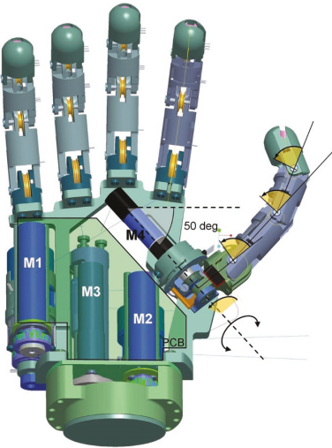
SmartHand (2011)
Four DC Brushed Motors:
M1 - flexion/extension of the thumb
M2 - flexion/extension of index
M3 - synchronous flexion/extension of the last three fingers
M4 - abduction/adduction of the thumb
Nylon Coated Steel Tendons
Equipped with 32 Proprioceptive and Exteroceptive Sensors
Customized Control Architecture Embedded in the Palm
Cipriani et al. (2011). The SmartHand transradial prosthesis. Journal of neuroengineering and rehabilitation. 8. 29. 10.1186/1743-0003-8-29.
Notes:
The second case of study is the SmartHand, designed with four DC Brushed Motors, one more compared to the MyHand, which is M4, used for controlling the abduction/adduction of the thumb. The hand is equipped with 32 proprioceptive and exteroceptive sensors, along with a complex control architecture embedded in the palm.

Slide 12

Pros and Cons Comparison
SSSA-MyHand
Designed for Real-World Use
SmartHand
Designed for Laboratory Experiments
✓ Anthropomorphic Design (Size, Weight - 478g)
✓ Robust and Low Cost
✓ Time to Complete a Grasp - 270ms
X Limited Sensory Feedback
X 4 DoFs
✓ Advanced Sensory Feedback and Control
✓ 16 DoFs (closer to human hand - 27 DoFs)
X Weight (530g)
X Complex and High Cost
X Time to Complete a Grasp - 1.5s
Notes:
Let’s compare the two hands: MyHand is designed for practical, everyday use - it is compact, low cost, faster and designed to resemble a human hand. Whereas the SmartHand is designed for laboratory experiments - it is more expensive and complex, offering an advanced sensory feedback and superior control capabilities.

Slide 13
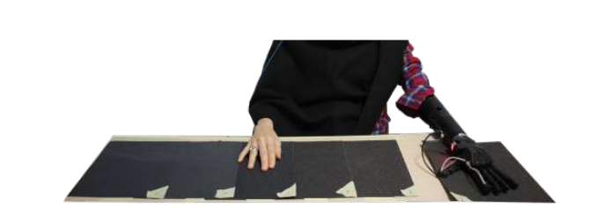
Sensory Feedback - System Overview
Introduction:
Growing interest in vibrotactile feedback in prosthetics.
Limited integration of high-frequency tactile information in prostheses.
VIBES System:
Wearable vibrotactile system for prosthetic sockets.
Compact planar vibrotactile actuators in direct skin contact.
Utilizes acceleration profiles from IMUs on the robotic prosthesis (SoftHand Pro).
Objectives:
Transmit high-frequency tactile information (e.g., surface roughness) to prosthetic users.
Achieve somatotopic matching (SM) and modality matching (MM) paradigms.
Notes:
Sensory feedback is crucial in prosthetics, impacting cognition and behavior. While sensorized prostheses with feedback exist, their limited commercial availability requires careful consideration for intuitive integration. Vibrotactile stimulation, known for signal modulation, holds promise but is not consistently integrated. Our solution, the Vibro-Inertial Bionic Enhancement System (VIBES), integrated with the SoftHand Pro, efficiently transmits texture and contact cues to specific stump sites, achieving modality matching and compensating for the SoftHand Pro's lack of intrinsic somatosensory feedback.

Slide 14
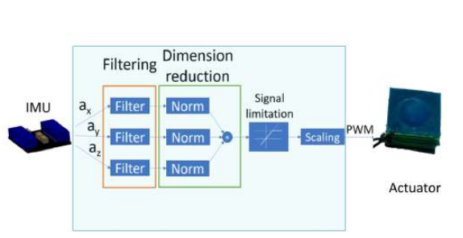
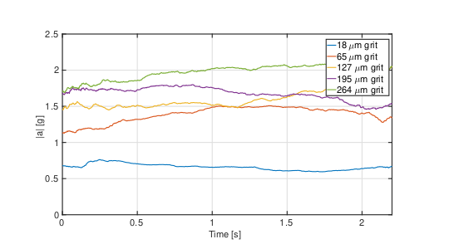
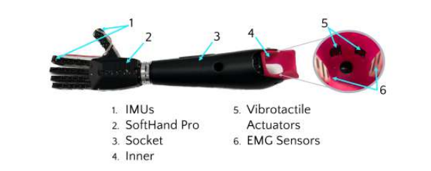
Experimental Characterization and Design
Experimental Characterization:
Psychophysical study with 15 able-bodied participants.
Computing the Just Noticeable Difference (JND) for discrimination of vibrotactile cues.
Positive results: Users could detect and distinguish contact and texture cues.
System Design:
Integration of Haptuator Planar (HP) actuators into the inner socket.
Control strategy maps IMU-acceleration signals to activate corresponding actuators.
Notes:
The VIBES system, integrated into the inner socket, features two Haptuator Planar (HP) vibrotactile actuators, part of the structural frame of the SoftHand Pro (SHP) prosthetic hand. The mechanical components include a battery pack, electronic board, and two IMUs. The HP actuators, with a compact design and high bandwidth, are suitable for prosthetic integration. The control strategy involves filtering and scaling IMU-recorded acceleration signals in real-time, following a somatotopic paradigm. Physical characterization tests the HP's performance in replicating tactile input signals, while psychophysical characterization assesses users' ability to discriminate roughness levels. The experiment utilizes the method of constant stimuli to calculate the Just Noticeable Difference (JND) for roughness discrimination.

Slide 15
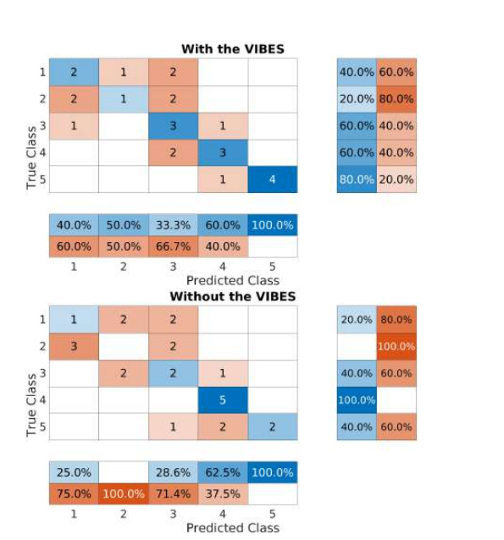
Experimental Results and Conclusions
Pilot Experiments with Prosthetic User:
Positive outcomes in roughness discrimination.
Active Texture Identification Experiment showed improvement with VIBES feedback.
System Usability Scale (SUS) questionnaire indicated a positive user experience.
Conclusion and Future Directions:
VIBES is a promising solution for transmitting and restoring tactile feedback.
Acknowledgment of preliminary nature and plans for further research.
Mention potential areas for improvement and expansion of the study.
Notes:
The outcomes of the Active Texture Identification experiments are depicted in Fig. 8. The confusion matrices reveal a significant enhancement in sandpaper identification when the participant utilizes the feedback device compared to when it is absent. The overall accuracy with VIBES was 52%, whereas without VIBES, it was 40%. Additionally, the SUS questionnaire yielded a positive score of 77.5 (with an average SUS score of 68 at the 50th percentile). (modificato)[23:38]

Slide 16
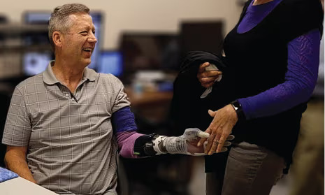
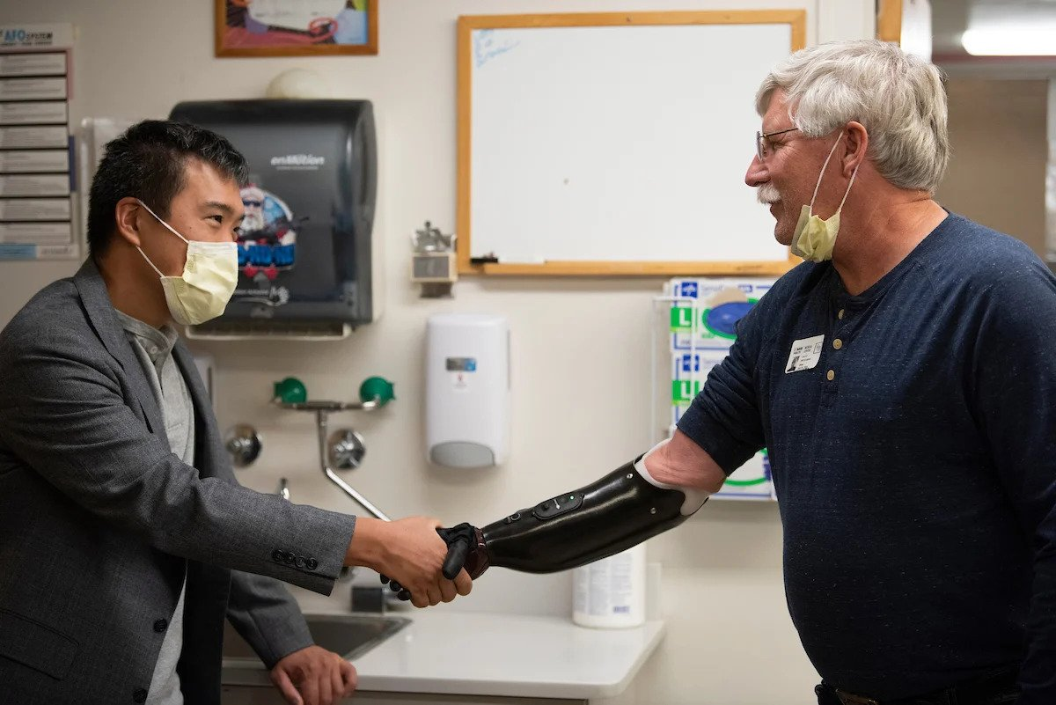
Conclusions
Remarkable progress and innovation in the field of prosthetic technology, encompassing the intricate design and future aspirations of all of these technologies
Together, these insights underscore a collective dedication to advancing prosthetic capabilities
They also illuminate the persistent challenges of standardization and the ongoing pursuit of interdisciplinary collaboration to ensure the continued evolution and optimal integration of these technologies for the benefit of prosthetic users worldwide
Notes:
In summary, the conclusions highlight significant advancements in prosthetic technology, including the design of the 16 DoFs SmartHand, the potential of implantable EMG systems, the transformative impact of Targeted Muscle Reinnervation (TMR), common control techniques, and the promising application of tactile feedback through the VIBES device. These insights underscore a dedication to advancing prosthetic capabilities, while also emphasizing the challenges of standardization and the need for interdisciplinary collaboration to optimize integration for global prosthetic users.

Slide 17
Thank You For Listening
We’d Be Happy To Answer Any Question

